Slide 1
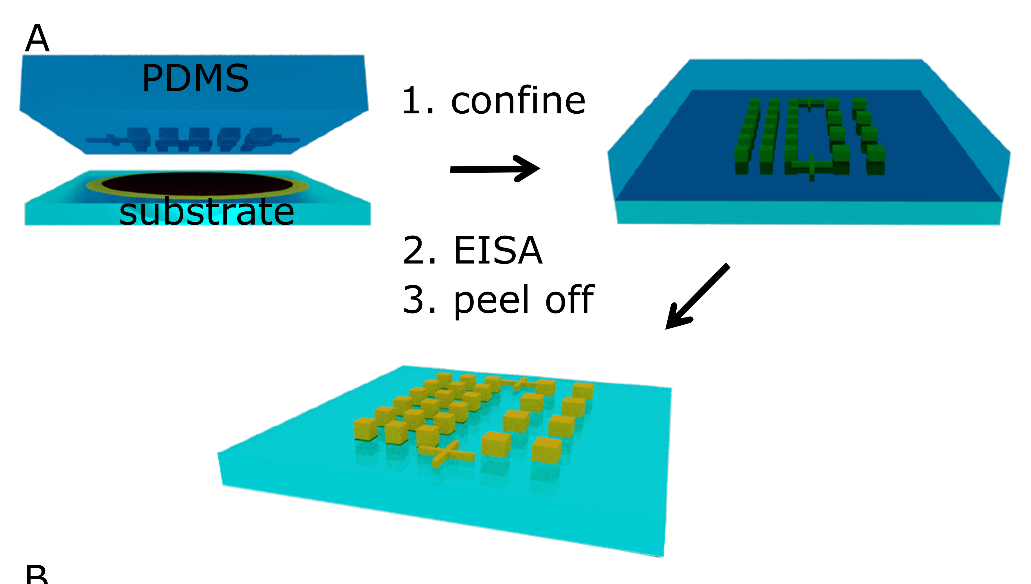
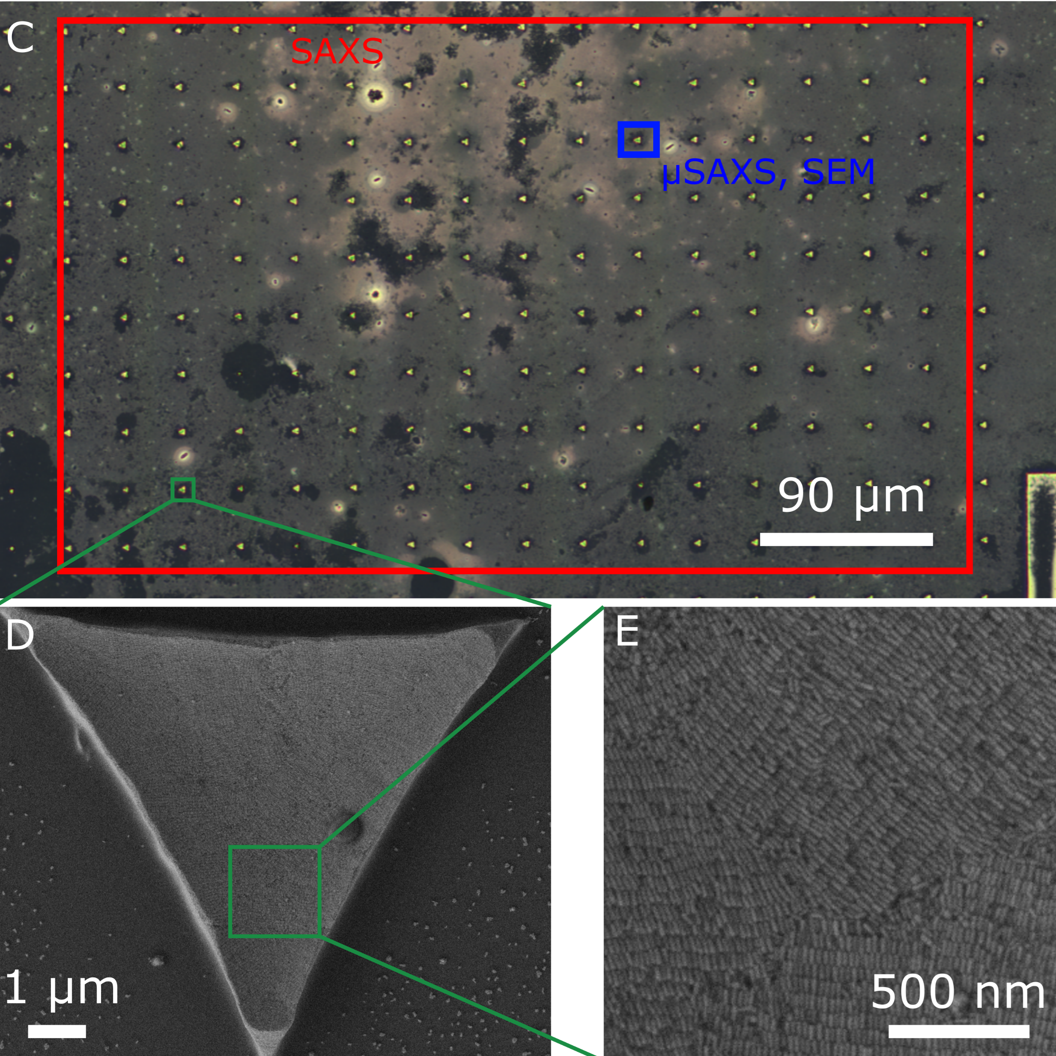
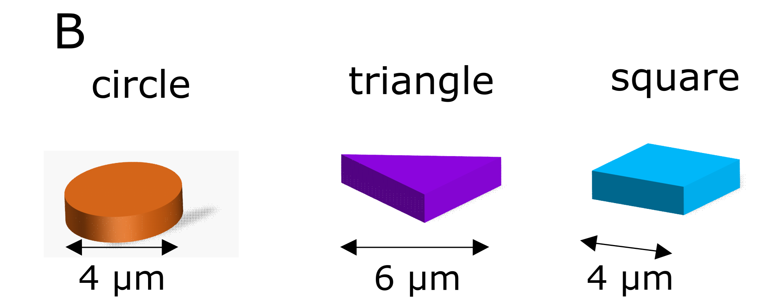
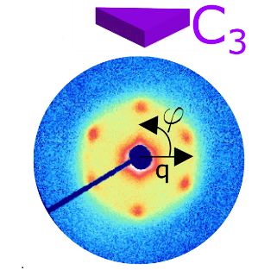
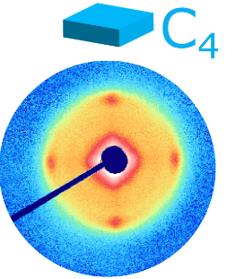
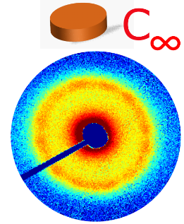
F

Slide 2


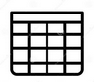

For Circle, Triangle, Square
*.nxs
extract_nxs_folder
data_eiger
Select First Channel
geometry_raw.npy
data_raw
logarithm
print_image_stats
data_log
Crop images
create_video_from_images
data_crop
Remove outliers pixels
Geometry_video.mp4
data_clip
Normalize pixels 0 -1
data_norm
Resize image
data_resized
circle_data_preproces.npy
triangle_data.preprocess.npy
Square_data.preprocess.npy

Slide 3
circle_data_preproces.npy
triangle_data.preprocess.npy
Square_data.preprocess.npy
Concatenate circle_data_preproces.npy
Create labels y
y_circle
y_square
y_triangle
X
Reshape for Keras
concatenate labels y
X
y
Shuffle data
X
y
Split data in train and test
X_train
X_test
y_train
Y_test

